Slide 1
RAFFINE
Flower shop - the first project
Team 2
김도빈 정희정 황정욱 지은희 김보민

Slide 2
INDEX
1
기획 의도 및 컨셉
2
개발환경
3
다이어그램 및 데이터베이스 관계도
4
시연

Slide 3
기획 의도
및
컨셉

Slide 4
1
Project Goal
다양한 기능 구현을 통한 웹에 대한 학습
Model2에 대한 정확한 이해
온라인에서의 안타까운 꽃 쇼핑몰 개선

Slide 5
개발환경

Slide 6
2
Web development environment
OS : Window 7
WAS : Web application server
- Tomcat 7.0
Tool : eclipse
& photo shop

Slide 7
다이어그램
및
DB관계도

Slide 8
3
MVC
HttpServlet
FrontController
+ init(SrvletConfig):void # doPost(HttpServletRequest, HttpServletResponse):void # doGet(HttpServletRequest, HttpServletResponse):void - requerstProcess(HttpServletRequest, HttpServletResponse):void
<<interface>> CommandAction
+process(HttpServletRequest, HttpServletResponse):String

Slide 9
3
FormAction
+process():String
ProAction
+process():String
AboutUs, Florist
DAO
+userCheck(String):int
Bean
c_id
…
…
Customer, Gallery, Review, Weekly, Order, Basket, ContactUs

Slide 10
3
Customer/Gallery/Order/Flower
Gallery
g_num :int g_title :String g_content:String g_imgname:String g_price:String
Customer
- c_id:String - c_pwd:String - c_name:String - c_addr:String - c_q:String - c_qa:String - c_phone:String - c_email:String - mileage:int - c_ocount:int - c_level:int
pk
pk
Order
o_id:String g_title:String g_imgname:String c_id:String o_msg:String o_date:Date o_shipdate:Date g_num:int o_sum:int
pk
fk
Flower
- f_id :String - f-name :String - f_price :String
fk
pk

Slide 11
3
Review
Review
r_num:int r_id:String r_imgname:String r_subject:String r_content:String r_date:Timestamp
Customer
- c_id:String - c_pwd:String - c_name:String - c_addr:String - c_q:String - c_qa:String - c_phone:String - c_email:String - mileage:int - c_ocount:int - c_level:int
pk
fk
pk
Review reply
rp_num:int rp_content:String c_id:String rp_date:Date r_num:int
pk
fk
fk

Slide 12
3
Weekly
Weekly
w_num:int w_title:String w_content:String w_imgname:String
Customer
- c_id:String - c_pwd:String - c_name:String - c_addr:String - c_q:String - c_qa:String - c_phone:String - c_email:String - mileage:int - c_ocount:int - c_level:int
pk
pk
Weekly reply
wre_num:int wre_date:Date c_id:String wre_content:String w_num:int
pk
fk
fk

Slide 13
3
Basket
Gallery
g_num :int g_title :String g_content:String g_imgname:String g_price:String
pk
Customer
- c_id:String - c_pwd:String - c_name:String - c_addr:String - c_q:String - c_qa:String - c_phone:String - c_email:String - mileage:int - c_ocount:int - c_level:int
pk
Basket
b_num:int g_num:int g_imgname:String g_title:String c_id:String b_sum:String g_msg:String
pk
fk
fk

Slide 14
시연

Slide 15
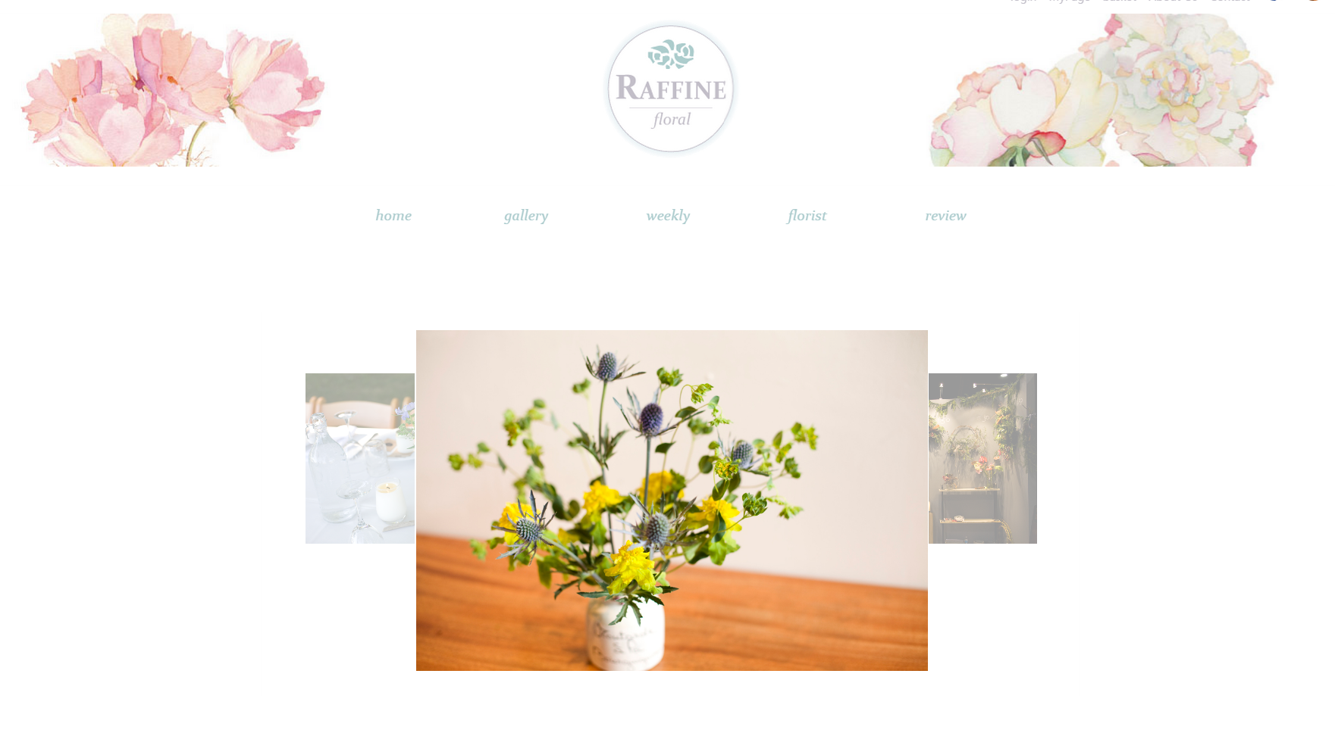
4
Preview
http://192.168.7.38:8080/Rproject/main.do

